Slide 1
Query Optimization
Overview
Transformation of Relational Expressions
Equivalence Rules
Size estimation of query operations:
Catalog Information for Cost Estimation
Cost-based optimization
Dynamic Programming for Choosing Evaluation Plans
Heuristics in Optimization

Slide 2
Overview
Query Optimization is the process of selecting the most efficient query-evaluation plan from among the many strategies usually possible for processing a given query.
Do not expect programmers to write queries that can be processed efficiently (This was true before relational database system)
Do expect the system to construct a query-evaluation plan that minimizes the cost.
Two aspects of optimization
Relational-algebra level: to find an efficient expression that equivalent to the given expression.
To select a detailed strategy for processing the query, such as choosing the algorithm, etc.
To choose among different query evaluation plans, the optimizer has to estimate the cost of each evaluation play.
Disk access dominates the cost of processing a query.

Slide 3
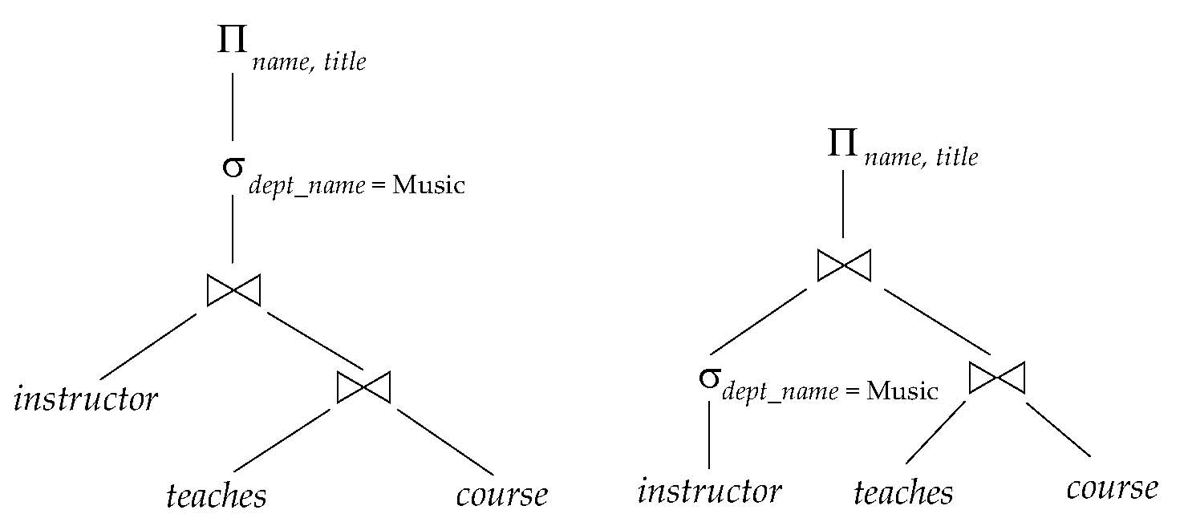
Equivalent expressions
Alternative ways of evaluating a given query
Equivalent expressions
Different algorithms for each operation

Slide 4
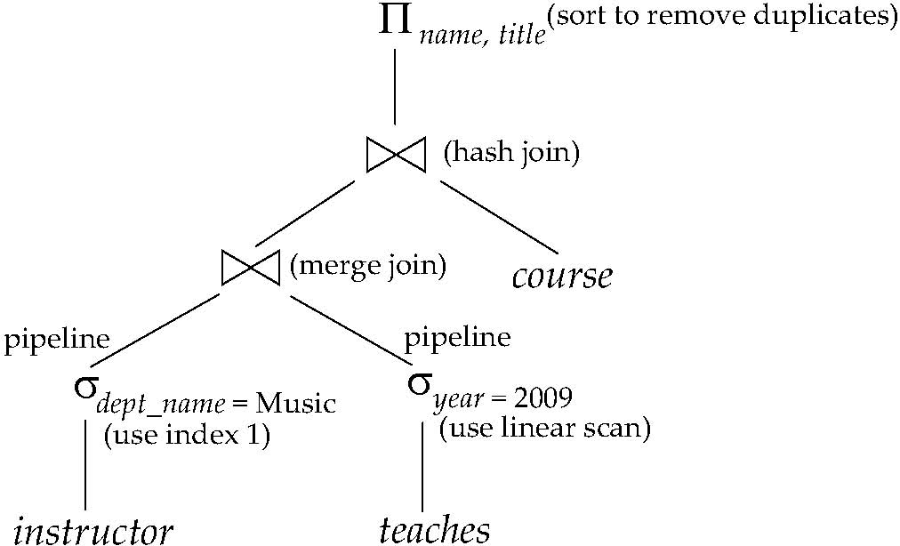
Evaluation plan
An evaluation plan defines exactly what algorithm is used for each operation, and how the execution of the operations is coordinated.
Find out how to view query execution plans on your favorite database

Slide 5
Introduction of cost-based optimization
Cost difference between evaluation plans for a query can be enormous
E.g. seconds vs. days in some cases
Steps in cost-based query optimization
Generate logically equivalent expressions using equivalence rules
Annotate resultant expressions to get alternative query plans
Choose the cheapest plan based on estimated cost
Estimation of plan cost based on:
Statistical information about relations. Examples:
number of tuples, number of distinct values for an attribute
Statistics estimation for intermediate results
to compute cost of complex expressions
Cost formulae for algorithms, computed using statistics

Slide 6
Transformation of Relational Expressions
Two relational algebra expressions are said to be equivalent if the two expressions generate the same set of tuples on every legal database instance
order of tuples is irrelevant
In SQL, inputs and outputs are multisets of tuples
Two expressions in the multiset version of the relational algebra are said to be equivalent if the two expressions generate the same multiset of tuples on every legal database instance.
An equivalence rule says that expressions of two forms are equivalent
Can replace expression of first form by second, or vice versa

Slide 7
Equivalence Rules
1. Conjunctive selection operations can be deconstructed into a sequence of individual selections.
2. Selection operations are commutative.
3. Only the last in a sequence of projection operations is needed, the others can be omitted.
4. Selections can be combined with Cartesian products and theta joins.
σ_{θ}(E₁ X E₂) = E₁ _{θ} E₂
σ_{θ1}(E₁ _{θ2} E₂) = E₁ _{θ1∧ θ2} E₂

Slide 8
Equivalence Rules (Cont.)
5. Theta-join operations (and natural joins) are commutative. E_{1 θ} E₂ = E₂ _{θ} E₁
6. (a) Natural join operations are associative:
(E₁ E₂) E₃ = E₁ (E₂ E₃) (b) Theta joins are associative in the following manner: (E_{1 θ1} E₂) _{θ2∧ θ3} E₃ = E_{1 θ1∧ θ3} (E₂ _{θ2} E₃) where θ₂ involves attributes from only E₂ and E₃.

Slide 9
Equivalence Rules (Cont.)
The selection operation distributes over the theta join operation under the following two conditions:
(a) When all the attributes in θ₀ involve only the attributes of one of the expressions (E₁) being joined. σ_{θ0}(E₁ _{θ} E₂) = (σ_{θ0}(E₁)) _{θ} E₂
(b) When θ ₁ involves only the attributes of E₁ and θ₂ involves only the attributes of E₂.
σ_{θ1}∧_{θ2} (E₁ _{θ} E₂) = (σ_{θ1}(E₁)) _{θ} (σ_{θ2} (E₂))

Slide 10
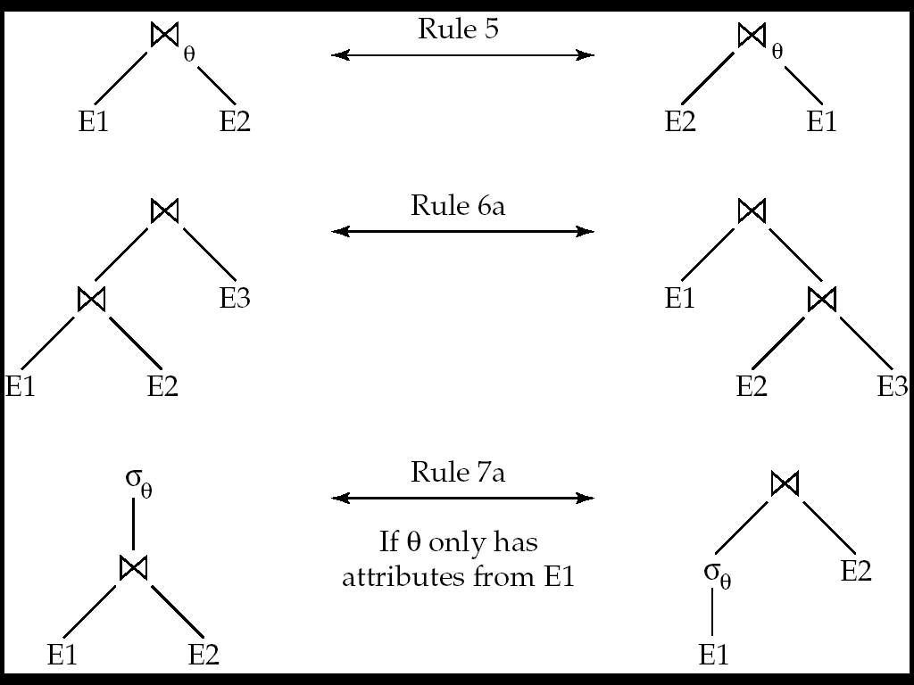
Pictorial Depiction of Equivalence Rules

Slide 11
Equivalence Rules (Cont.)
8. The projection operation distributes over the theta join operation as follows:
(a) if θ involves only attributes from L₁ ∪ L₂:
(b) Consider a join E_{1 θ} E₂ .
Let L₁ and L₂ be sets of attributes from E₁ and E₂, respectively.
Let L₃ be attributes of E₁ that are involved in join condition θ, but are not in L₁ ∪ L₂, and
let L₄ be attributes of E₂ that are involved in join condition θ, but are not in L₁ ∪ L₂.
∏
(
E
E
)
=
(
∏
(
E
))
(
∏
(
E
))
L
1
∪
L
2
1
θ
2
L
1
1
θ
L
2
2
∏
(
E
E
)
=
∏
((
∏
(
E
))
(
∏
(
E
)))
L
1
∪
L
2
1
θ
2
L
1
∪
L
2
L
1
∪
L
3
1
θ
L
2
∪
L
4
2

Slide 12
Equivalence Rules (Cont.)
9. The set operations union and intersection are commutative E₁ ∪ E₂ = E₂ ∪ E₁ E₁ ∩ E₂ = E₂ ∩ E₁
(set difference is not commutative).
10. Set union and intersection are associative.
(E₁ ∪ E₂) ∪ E₃ = E₁ ∪ (E₂ ∪ E₃) (E₁ ∩ E₂) ∩ E₃ = E₁ ∩ (E₂ ∩ E₃)
11. The selection operation distributes over ∪, ∩ and –. σ_{θ} (E₁ – E₂) = σ_{θ} (E₁) – σ_{θ}(E₂) and similarly for ∪ and ∩ in place of – Also: σ_{θ} (E₁ – E₂) = σ_{θ}(E₁) – E₂ and similarly for ∩ in place of –, but not for ∪
12. The projection operation distributes over union
Π_{L}(E₁ ∪ E₂) = (Π_{L}(E₁)) ∪ (Π_{L}(E₂))

Slide 13
Transformation Example: Pushing Selections
Query: Find the names of all instructors in the Music department, along with the titles of the courses that they teach
Π_{name, title}(σ_{dept_name= “Music”} (instructor (teaches Π_{course_id, title} (course))))
Transformation using rule 7a.
Π_{name, title}((σ_{dept_name= “Music”}(instructor)) (teaches Π_{course_id, title} (course)))
Performing the selection as early as possible reduces the size of the relation to be joined.

Slide 14
Example with Multiple Transformations
Query: Find the names of all instructors in the Music department who have taught a course in 2009, along with the titles of the courses that they taught
Π_{name, title}(σ_{dept_name= “Music”∧year = 2009} (instructor (teaches Π_{course_id, title} (course))))
Transformation using join associatively (Rule 6a):
Π_{name, title}(σ_{dept_name= “Music”∧year = 2009} ((instructor teaches) Π_{course_id, title} (course)))
Second form provides an opportunity to apply the “perform selections early” rule, resulting in the subexpression
σ_{dept_name = “Music”} (instructor) σ _{year = 2009} (teaches)

Slide 15
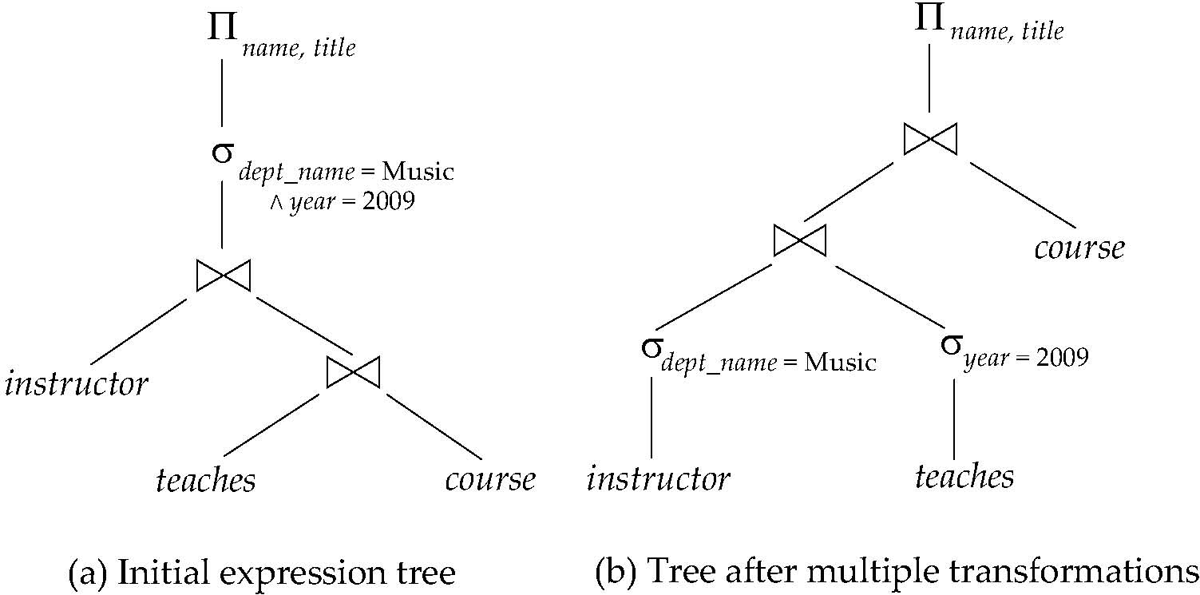
Multiple Transformations (Cont.)

Slide 16
Transformation Example: Pushing Projections
Consider: Π_{name, title}(σ_{dept_name= “Music”} (instructor) teaches) Π_{course_id, title} (course))))
When we compute
(σ_{dept_name = “Music”} (instructor teaches) we obtain a relation whose schema is: (ID, name, dept_name, salary, course_id, sec_id, semester, year)
Push projections using equivalence rules 8a and 8b; eliminate unneeded attributes from intermediate results to get: Π_{name, title}(Π_{name, course_id} ( σ_{dept_name= “Music”} (instructor) teaches)) Π_{course_id, title} (course))))
Performing the projection as early as possible reduces the size of the relation to be joined.

Slide 17
Join Ordering
For all relations r_{1,} r_{2,} and r₃,
(r₁ r₂) r₃ = r₁ (r₂ r₃ )
(Join Associativity)
If r₂ r₃ is quite large and r₁ r₂ is small, we choose
(r₁ r₂) r₃
so that we compute and store a smaller temporary relation.

Slide 18
Join Ordering Example
Consider the expression
Π_{name, title}(teaches Π_{course_id, title} (course) σ_{dept_name= “Music”} (instructor))
Could compute teaches Π_{course_id, title} (course) first, and join result with σ_{dept_name= “Music”} (instructor) but the result of the first join is likely to be a large relation.
Only a small fraction of the university’s instructors are likely to be from the Music department
it is better to compute
σ_{dept_name= “Music”} (instructor) teaches
first.

Slide 19
Enumeration of Equivalent Expressions
Query optimizers use equivalence rules to systematically generate expressions equivalent to the given expression
Can generate all equivalent expressions as follows:
Repeat
apply all applicable equivalence rules on every subexpression of every equivalent expression found so far
add newly generated expressions to the set of equivalent expressions
Until no new equivalent expressions are generated above
The above approach is very expensive in space and time
Two approaches
Optimized plan generation based on transformation rules
Special case approach for queries with only selections, projections and joins

Slide 20
Implementing Transformation Based Optimization*
Space requirements reduced by sharing common sub-expressions:
when E1 is generated from E2 by an equivalence rule, usually only the top level of the two are different, subtrees below are the same and can be shared using pointers
E.g. when applying join commutativity
Same sub-expression may get generated multiple times
Detect duplicate sub-expressions and share one copy
Time requirements are reduced by not generating all expressions
Dynamic programming
We will study only the special case of dynamic programming for join order optimization
E1
E2

Slide 21
Cost Estimation
Cost of each operator computed as described in Chapter 12
Need statistics of input relations
E.g. number of tuples, sizes of tuples
Inputs can be results of sub-expressions
Need to estimate statistics of expression results
To do so, we require additional statistics
E.g. number of distinct values for an attribute

Slide 22
Statistical Information for Cost Estimation
n_{r}: number of tuples in a relation r.
b_{r}: number of blocks containing tuples of r.
l_{r}: size of a tuple of r.
f_{r}: blocking factor of r — i.e., the average number of tuples of r that fit into one block.
V(A, r): number of distinct values that appear in r for attribute A; same as the size of ∏_{A}(r).
If tuples of r are stored together physically in a file, then:

Slide 23
Histograms
Histogram on attribute age of relation person
Equi-width histograms
Equi-depth histograms

Slide 24
Selection Size Estimation
σ_{A=v}(r)
n_{r} / V(A,r) : number of records that will satisfy the selection
Equality condition on a key attribute: size estimate = 1
σ_{A≤V}(r) (case of σ_{A ≥ V}(r) is symmetric)
Let c denote the estimated number of tuples satisfying the condition.
If min(A,r) and max(A,r) are available in catalog
c = 0 if v < min(A,r)
c =
If histograms available, can refine above estimate
In absence of statistical information c is assumed to be n_{r} / 2.

Slide 25
Size Estimation of Complex Selections
The selectivity of a condition θ_{i} is the probability that a tuple in the relation r satisfies θ_{i} .
If s_{i} is the number of satisfying tuples in r, the selectivity of θ_{i} is given by s_{i} /n_{r}.
Conjunction: σ_{θ1∧ θ2∧. . . ∧ θn} (r). Assuming indepandence, estimate of tuples in the result is:
Disjunction:σ_{θ1∨} _{θ2 ∨. . . ∨} _{θn} (r). Estimated number of tuples:
Negation: σ_{¬θ}(r). Estimated number of tuples: n_{r} – size(σ_{θ}(r))

Slide 26
Estimation of the Size of Joins
The Cartesian product r x s contains n_{r} .n_{s} tuples; each tuple occupies l_{r} + l_{s} bytes.
If R ∩ S = ∅, then r s is the same as r x s.
If R ∩ S is a key for R, then a tuple of s will join with at most one tuple from r
therefore, the number of tuples in r s is no greater than the number of tuples in s.
If R ∩ S in S is a foreign key in S referencing R, then the number of tuples in r s is exactly the same as the number of tuples in s.
The case for R ∩ S being a foreign key referencing S is symmetric.

Slide 27
Estimation of the Size of Joins (Cont.)
If R ∩ S = {A} is not a key for R or S. If we assume that every tuple t in R produces tuples in R S, the number of tuples in R S is estimated to be: If the reverse is true, the estimate obtained will be: The lower of these two estimates is probably the more accurate one.
Can improve on above if histograms are available
Use formula similar to above, for each cell of histograms on the two relations

Slide 28
Example of Join size estimation
Running example: student takes
Catalog information for join examples:
n_{student} = 5,000.
f_{student} = 50, which implies that b_{student} =5000/50 = 100.
n_{takes} = 10000.
f_{takes} = 25, which implies that b_{takes} = 10000/25 = 400.
V(ID, takes) = 2500, which implies that on average, each student who has taken a course has taken 4 courses.
Attribute ID in takes is a foreign key referencing student.
V(ID, student) = 5000 (primary key!)

Slide 29
Example of Join size estimation
In the example query student takes, ID in takes is a foreign key referencing student
hence, the result has exactly n_{takes} tuples, which is 10000
Compute the size estimates for student takes without using information about foreign keys:
V(ID, takes) = 2500, and V(ID, student) = 5000
The two estimates are 5000 * 10000/2500 = 20,000 and 5000 * 10000/5000 = 10000
We choose the lower estimate, which in this case, is the same as our earlier computation using foreign keys.

Slide 30
Size Estimation for Other Operations
Projection: estimated size of ∏_{A}(r) = V(A,r)
Aggregation : estimated size of _{A}g_{F}(r) = V(A,r)
Set operations
For unions/intersections of selections on the same relation: rewrite and use size estimate for selections
E.g. σ_{θ1} (r) ∪ σ_{θ2} (r) can be rewritten as σ_{θ1 ˅ θ2} (r)
For operations on different relations:
estimated size of r ∪ s = size of r + size of s.
estimated size of r ∩ s = minimum size of r and size of s.
estimated size of r – s = r.
All the three estimates may be quite inaccurate, but provide upper bounds on the sizes.

Slide 31
Size Estimation for Outer join
Outer join:
Estimated size of r s = size of r s + size of r
Case of right outer join is symmetric
Estimated size of r s = size of r s + size of r + size of s
All the three estimates may be quite inaccurate, but provide upper bounds on the sizes

Slide 32
Estimation of Number of Distinct Values
To estimate the size of V(A,σ_{θ} (r))
If θ forces A to take a specified value: V(A,σ_{θ} (r)) = 1.
e.g., A = 3
If θ forces A to take on one of a specified set of values: V(A,σ_{θ} (r)) = number of specified values.
(e.g., (A = 1 V A = 3 V A = 4 )),
If the selection condition θ is of the form A op r estimated V(A,σ_{θ} (r)) = V(A.r) * s
where s is the selectivity of the selection.
In all the other cases: use approximate estimate of min(V(A,r), n_{σθ (r)} )
More accurate estimate can be got using probability theory, but this one works fine generally

Slide 33
Estimation of Distinct Values (Cont.)*
Joins: r s
If all attributes in A are from r estimated V(A, r s) = min (V(A,r), n _{r s})
If A contains attributes A1 from r and A2 from s, then estimated V(A,r s) =
min(V(A1,r)*V(A2 – A1,s), V(A1 – A2,r)*V(A2,s), n_{r s})
More accurate estimate can be got using probability theory, but this one works fine generally

Slide 34
Estimation of Distinct Values (Cont.)*
Estimation of distinct values are straightforward for projections.
They are the same in ∏_{A (r)} as in r.
The same holds for grouping attributes of aggregation.
For aggregated values
For min(A) and max(A), the number of distinct values can be estimated as min(V(A,r), V(G,r)) where G denotes grouping attributes
For other aggregates, assume all values are distinct, and use V(G,r)

Slide 35
Choice of Evaluation Plans
Must consider the interaction of evaluation techniques when choosing evaluation plans
choosing the cheapest algorithm for each operation independently may not yield best overall algorithm. E.g.
merge-join may be costlier than hash-join, but may provide a sorted output which reduces the cost for an outer level aggregation.
nested-loop join may provide opportunity for pipelining
Practical query optimizers incorporate elements of the following two broad approaches:
1. Search all the plans and choose the best plan in a cost-based fashion.
2. Uses heuristics to choose a plan.

Slide 36
Cost-Based Join-order Optimization
Consider finding the best join-order for r₁ r₂ . . . r_{n}.
There are (2(n – 1))!/(n – 1)! different join orders for above expression. With n = 7, the number is 665280, with n = 10, the number is greater than 176 billion!
No need to generate all the join orders. Using dynamic programming, the least-cost join order for any subset of {r₁, r₂, . . . r_{n}} is computed only once and stored for future use.

Slide 37
Dynamic Programming in Optimization
To find best join tree for a set of n relations:
To find best plan for a set S of n relations, consider all possible plans of the form: S₁ (S – S₁) where S₁ is any non-empty subset of S.
Recursively compute costs for joining subsets of S to find the cost of each plan. Choose the cheapest of the 2^{n} – 2 alternatives.
Base case for recursion: single relation access plan
Apply all selections on R_{i} using best choice of indices on R_{i}
When plan for any subset is computed, store it and reuse it when it is required again, instead of recomputing it
Dynamic programming
To find best join tree for a set of n relations:

Slide 38
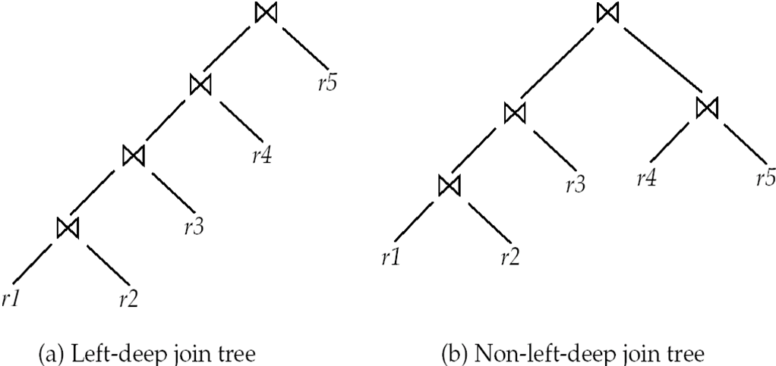
Left Deep Join Trees
In left-deep join trees, the right-hand-side input for each join is a relation, not the result of an intermediate join.

Slide 39
Simplify the algorithm
With dynamic programming time complexity of optimization with bushy trees is O(3^{n}).
With n = 10, this number is 59000 instead of 176 billion!
But still big
To find best left-deep join tree for a set of n relations:
Consider n alternatives with one relation as right-hand side input and the other relations as left-hand side input.
Modify optimization algorithm:
Replace “for each non-empty subset S1 of S such that S1 ≠ S”
By: for each relation r in S let S1 = S – r .
If only left-deep trees are considered, time complexity of finding best join order is O(n 2^{n})
Cost-based optimization is expensive, but worthwhile for queries on large datasets (typical queries have small n, generally < 10)

Slide 40
Heuristic Optimization
Cost-based optimization is expensive, even with dynamic programming.
Systems may use heuristics to reduce the number of choices that must be made in a cost-based fashion.
Heuristic optimization transforms the query-tree by using a set of rules that typically (but not in all cases) improve execution performance:
Perform selection early (reduces the number of tuples)
Perform projection early (reduces the number of attributes)
Perform most restrictive selection and join operations (i.e. with smallest result size) before other similar operations.
Many optimizers considers only left-deep join orders.
Algorithm in some early versions of Oracle: Repeatedly pick “best” relation to join next;Starting from each of n starting points. Pick best among these.

Slide 41
Structure of Query Optimizers
Some systems use only heuristics, others combine heuristics with partial cost-based optimization.
Pipelined evaluation plan is preferred
Optimization cost budget to stop optimization early (if cost of plan is less than cost of optimization)
Plan caching to reuse previously computed plan if query is resubmitted
Even with different constants in query
Even with the use of heuristics, cost-based query optimization imposes a substantial overhead.
But is worth it for expensive queries
Optimizers often use simple heuristics for very cheap queries, and perform exhaustive enumeration for more expensive queries

